Slide 1


Second-order Thinking
Decision-making pattern
Derrick Mar
Proactive consideration of long-term consequences

Slide 2
Some decisions seem like wins at first, but turn out to be losses over time. What seems like an investment now turns out to be a liability later. What looked like a good decision earlier is now a bad one.
Adam Amran (untools.co)

Slide 3
Key Mental Patterns
Before making a decision, ask yourself: what will be the consequences of this decision long-term?
First-order: What are the most immediate effects of making this decision?
Second-order: For each effect, ask yourself “and then what happens?”
Think about the decision in different lengths of time. What are the effects of the decision today, 1 month from now, 1 year from now

Slide 4
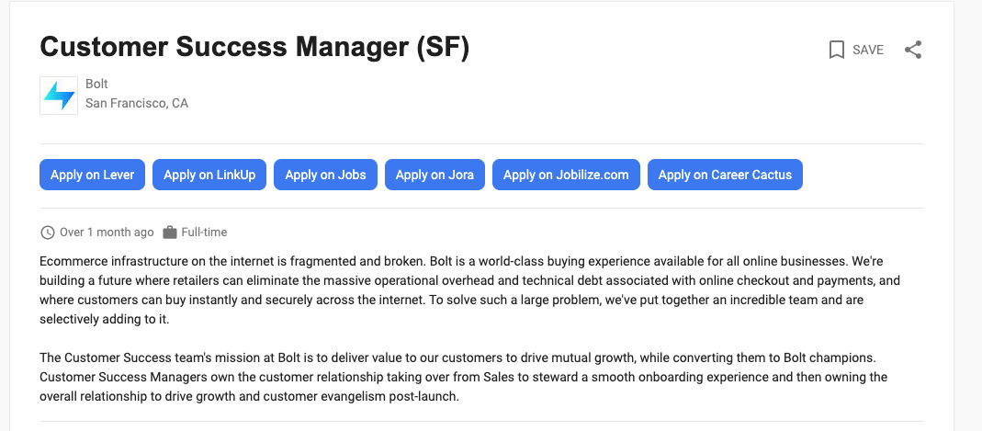
Example
Decision: I aspire to be a product manager, but I have an offer for a Customer Success Manager position at Bolt

Slide 5
Second Order Thinking
Decision: I aspire to be a product manager, but I have an offer for a Customer Success Manager (CSM) position at Bolt
Move to SF from rural area -> expansive network of PMs to talk to -> build relationships to get PM opportunities
Explore: Is the Bay Area a good choice for aspiring PMs?
Stop job search -> Work at Series B company -> Transition internally to PM
Explore: Will Bolt continue to grow and have PM opportunities around customer success? What is their appetite for transitioning roles for rockstar employees?
Stop job search -> build skills as a CSM -> hedge risk on being siloed into customer success
Explore: Talk to CSMs that transitioned to Product Managers

Slide 6
Example
Decision: OfficeMix Product at Microsoft. Retire OfficeMix. And natively integrate them in powerpoint in 2019.
# of users = 1.65 million
# of people kept growing in terms of people signing up even after being retired.
Support tickets started to be blanket issues (and may have led to frustration)
If to redo, block new sign-ups. Make it a read-only mode.
Definitely had issues long-term. New users were upset.
Second order decision:
The fact of number of growing of support tickets.
Comparing the # of existing users vs. new users..

Slide 7
Tell me about a time that you made a decision that led to short term gains, but was suboptimal long-term?
Behavioral Critique Question

Slide 8
Resources
https://fs.blog/2016/04/second-order-thinking/

